Slide 1

Wireless Network
By-
Dr. Jesmin Akhter
Professor
Institute of Information Technology
Jahangirnagar University

Slide 2
Contents
The course will mainly cover the following topics:
Wireless Networking
Multiple Access techniques
FDMA, TDMA and CDMA systems
Modulation Techniques
Analog and digital modulation techniques, Performance of various modulation techniques - Spectral efficiency, Error rate
The Cellular Concepts and System Design Fundamentals
Cellular concept and frequency reuse, Channel assignment and handoff, Interface and system capacity, Trunking and Erlang capacity calculations
Mobile Radio Propagation
Radio wave propagation issues in personal wireless systems, Propagation models, Multipath fading, Parameters of mobile multipath channels, Antenna systems in mobile radio.
Cellular Wireless Networks
Principles of Cellular Networks
First-Generation Analog
Second-Generation TDMA
Second-Generation CDMA
Third-Generation Systems

Slide 3
Outline
Cellular Wireless Networks
Open Loop Power Control vs Closed Loop Power Control
TDMA format
GSM Speech Processing
Notes:
https://www.mathworks.com/help/comm/ug/gsm-tdma-frame-parameterization-for-waveform-generation.html

Slide 4
Open Loop Power Control vs Closed Loop Power Control
Cellular system basically composed of two main entities- Base Station (BS) and Mobile subscriber Station (MSS). Base Station serves more than one mobile subscribers(MSs) in its coverage area.
Power control is very essential in cellular communication system due to following features.
To maintain Signal to Noise Ratio at the receiving end of a communication link for effective communication, It is required to increase the transmit power in the conditions when it goes down below the noise power level. This is due to transmitted power will get attenuated due to path loss as well as other factors on the path from transmitter to the receiver.
It is often required to reduce the transmit power to minimize the co-channel interference.
As BS in CDMA and other cellular systems receive transmissions from different mobile subscribers, it is required to equalize the power level from these subscribers.
There are two main types of power controls-Open Loop Power Control and Closed Loop Power Control used in the cellular system.

Slide 5
Open Loop Power Control
In the Open Loop Power Control, there is no feedback either from mobile to BS or from BS to mobile.
Let us take example of CDMA system wherein there is dedicated pilot channel provided for channel estimation. It is transmitted by the base station to all the subscribers.
The mobile unit receives the pilot channel and estimates the power strength. Based on this estimate, the mobile unit adjusts the transmit power accordingly.
During this open loop control, it is assumed that both forward link (from BS to MS) and reverse link (from MS to BS) are correlated.

Slide 6
Closed Loop Power Control
In the Closed Loop Power Control, feedback is used for adjusting the transmit power level.
Let us see how this is done in the forward link.
BS receives the mobile signal.
Based on this received power level as well as other parameters such as SNR and BER, Base station determines what is the optimum power level mobile need to transmit to achieve effective communication link performance.
This estimated power level is communicated to the mobile by the BS over control channel.
Mobile adjusts the power level accordingly using the feedback provided by the BS.
Often Mobile estimates the base station power level and communicates base station to adjust its power level to achieve effective reverse link performance.

Slide 7
TDMA format
In TDMA frame structure a data stream divided into frames and those frames divided into time slots.
The length of each time slots that are generated from the frequency channels is 0.577ms and these 8 slots make a TDMA frame of length 4.615ms. To implement TDMA, the uplink is more challenging than the downlink, since the transmissions from the mobiles must be synchronized such that they arrive at the appropriate time at the BS. In addition, guard times need to be included to avoid interference between TDMA slots.
There are main four burst present in the TDMA:-
Normal Burst(NB)
Frequency Correction Burst(FB)
Synchronization Burst(SB)
Access Burst(AB)

Slide 8
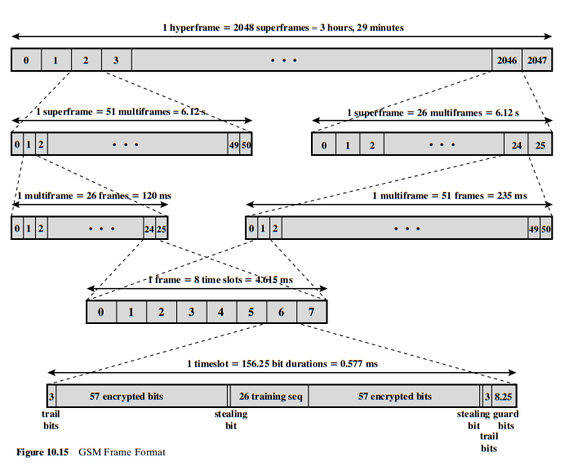
GSM Frame Format
NORMAL BURST

Slide 9
Normal Burst:- The transmission of the data during the single time slot is known as a burst. The normal burst carries traffic channels and all types of control channels. In the Normal Burst there are four types of bits as given below:-
Taril Bits :- In the diagram of TDMA there is 3 bits at both of the two ends , in which there is no transmission of the data. At the beginning the bit is used to rise up the power up to its peak during the transmission and the end it is used to down the power used at the end of the transmission. Within the duration of the trail symbols the transmitter is correspondingly switched on and off between the bursts.
Data Bit/Encrypted bits:- Around the training bits there are two data bits each of 57 bits. The data symbols DS intended for transferring user data and signalling data are divided into two sequences of 57 symbols which are located before the first stealing symbol and after the second stealing symbol.
Notes:
A guard time between the two time slots must be allowed in order to avoid interference, especially in the uplink direction. All mobiles should synchronize with the BS to minimize interference

Slide 10
Stealing Flags :- These are the flags around the training bits that are of length 1 bit and it is used to indicate that whether the burst is being used for voice or the data (set to 0)or whenever it is used for signalling (set to 1 ).
Training Sequence :- In the training bits a method is being used to overcome the problem of multi-path fading and the other propagation effects and in this 26 bits are used. This helps reduce the impact of ISI (Inter Symbol Interference).
Guard bits: After the burst, there is a guard period (G) of 8.25 bits that prevents adjacent time slots from overlapping in base station reception. Guard bits are used to provide synchronization of different receivers between different time slots and frames. All mobiles should synchronize with the BS to minimize interference
Notes:
A guard time between the two time slots must be allowed in order to avoid interference, especially in the uplink direction. All mobiles should synchronize with the BS to minimize interference

Slide 11
Frequency Correction Burst:- Used for frequency synchronization of the mobile stations. It is equivalent to an un-modulated carrier, shifted in frequency, with the same guard time as the normal burst. It is broadcast together with the BCCH. This burst carries FCCH downlink to correct the frequency of the MS’s local oscillator, effectively locking it to that of the BTS
Synchronization Burst:- The time synchronization of the mobile is possible with the help of synchronization burst .The payload used in this carries the FDMA frame number (FN) and Base Station Identity Code (BSIC). and the broadcasting in this case is with the frequency correction burst and also broadcasting occurs on the synchronization channel. So called because its function is to carry SCH downlink, synchronizing the timing of the MS to that of the BTS.
Access Burst:- Firstly the guard burst used in this very longer as compared to the normal burst , so it is 68.25bits1. The increased guard period is necessary because the timing of its transmission is unknown. The mobile stations use this type of the burst for random access. It also helps to measure the unknown distance of any mobile station from the tower , when the MS wants to access to the new BTS. The Access Burst is uplink only
Notes:
Access Burst:- This burst is of much shorter duration than the other types. The increased guard period is necessary because the timing of its transmission is unknown. When this burst is transmitted, the BTS does not know the location of the MS and therefore the timing of the message from the MS can not be accurately accounted for. (The Access Burst is uplink only.)

Slide 12
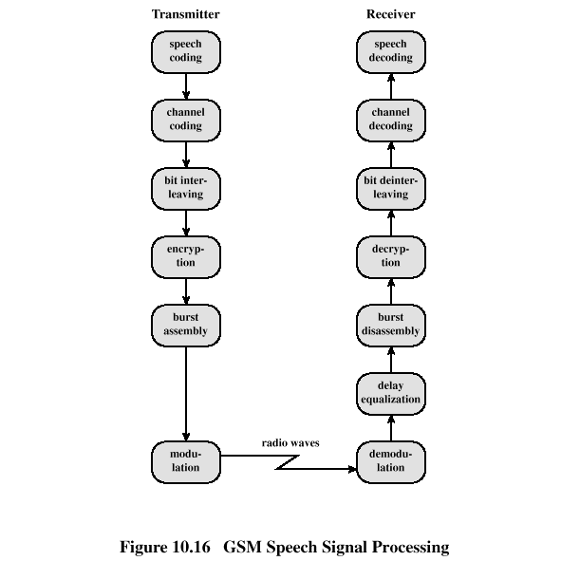
GSM Speech Processing

Slide 13
A. Speech coding:
GSM speech coder is RELP (Residually Excited Predictive Coder), which is enhanced by including a Long Term Predictor (LTP).
The coder provides 260 bits for 20ms blocks of speech, which yields a bit rate of 13kbps.
GSM system operates in Discontinuous Transmission mode (DTX) by incorporating a Voice Activity Detector (VAD) in speech coder. This mode provides a longer battery life and reduces instantaneous radio interference since GSM transmitter is not active during silent periods.
A Comfort Noise Subsystem (CNS) is used at receiver which adds background acoustic noise to compensate for the annoying switched muting which occurs due to DTX.

Slide 14
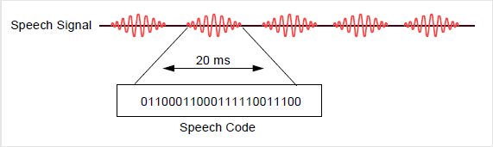
A. Speech coding:
The speech coder removes redundancy in the digital signal (such as silence periods)
This provides a speech quality which is acceptable for mobile telephony and comparable with wireline PSTN phones.

Slide 15
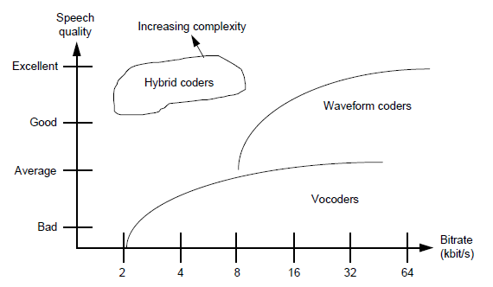
Comparison of speech coders
Many types of speech coders are available. Some offer better speech quality, at the expense of a higher bit rate (waveform coders). Others use lower bit rates, at the expense of lower speech quality (vocoders). The hybrid coder which GSM uses provides good speech quality with a relatively low bit rate, at the expense of speech coder complexity.

Slide 16
B. Channel coding:
The outputs of the speech coder are ordered into for error protection,
Out of 260 bits in a frame, the most important 50 bits called type Ia bits, have 3 parity check (CRC) bits added to them to detect non-correctable errors at the receiver.
The next 132 bits with first 53 are appended by 4 trailing zero bits, thus providing a data block of 189 bits. This block is then encoded for error protection using a rate ½ convolution encoder, thus providing a sequence of 378 bits.
The least important 78 bits do not have error protection and concatenated to existing sequence to form a block of 456 bits in 20ms frame, data rate of speech signal becomes 22.8kbps.
Notes:
A cyclic redundancy check (CRC) is an error-detecting code commonly used in digital networks and storage devices to detect accidental changes to raw data.

Slide 17
Channel coding
13kbps*20ms = 260bits = 50+132+78
50 very important bits
Block Coder
53
Convolution
Coder
1:2
378
132 important bits+ 4tail bits
456
78 not so important bits

Slide 18
C. Interleaving
Interleaving is the reordering of data that is to be transmitted so that consecutive bytes of data are distributed over a larger sequence of data to reduce the effect of burst errors. The use of interleaving greatly increases the ability of error protection codes to correct for burst errors. Many of the error protection coding processes can correct for small numbers of errors, but cannot correct for errors that occur in groups.

Slide 19
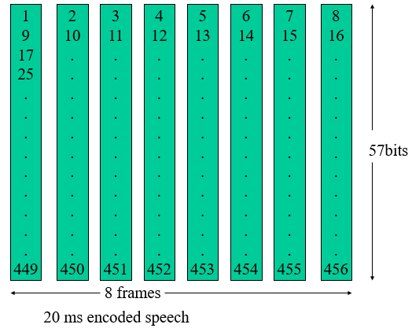
C. Interleaving
First level of interleaving
To minimize the effect of sudden fades on the received data, the total of 456 encoded bits within each 20ms speech frame or control message frame are broken into eight 57 bits sub blocks and they are numbered even odd according to block number. These eight consecutive blocks are spread over eight consecutive TCH time slot.
In a normal burst there is space for two of these speech blocks of 57 bits. Thus, if one burst transmission is lost, there is a 25% BER for the entire 20 ms of speech (2/8 = 25%).

Slide 20
Normal Burst
2*(3 head bit + 57 data bits + 1 signaling bit) + 26 training sequence bit + 8.25 guard bit
Duration of a burst = 576.9 μs ≈ 0.57ms = duration of TS of TDMA frame
If a burst is lost 25% of 20ms speech is lost
Notes:
The normal burst is used to transmit information on traffic and control (except RACH) channels. The bursts are separated through guard bands.
At the start and end of each burst are three tail bits which are always set to logical "0". These bits fill a short t ime span during which transmitter power is ramped up or down and during which no data transmission is possible.
The Stealing Flags (SF) are signalling bits which indicate whether the burst contains traffic data or signalling data.
A normal burst contains besides the synchronization and signalling bits two blocks of 57 bits each of error-protected and channel encoded user data separated by a 26-bit midamble.
This midamble consists of predefined, known bit patterns, the training sequences (discussed in detail later), which are used for channel estimation to optimize reception with an equalizer and for synchronization. With the help of these training sequences, the equalizer eliminates or reduces the intersymbol interferences which are caused by propogation time difference of the multipath propogation.

Slide 21
Second level of interleaving
If only one level of interleaving is used, a loss of this burst results in a total loss of 25%. This is too much for the channel decoder to correct. A second level of interleaving can be introduced to further reduce the possible BER to 12.5%. Instead of sending two blocks of 57 bits from the same 20 ms of speech within one burst, a block from one 20 ms and a block from next sample of 20 ms are sent together. A delay is introduced in the system when the MS must wait for the next 20 ms of speech. However, the system can now afford to loose a whole burst, out of eight, as the loss is only 12.5% of the total bits from each 20ms speech frame. 12.5% is the maximum loss level that channel decoder can correct.

Slide 22
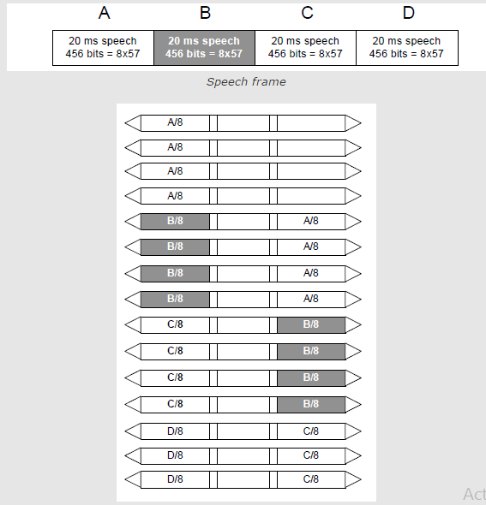
Second level of interleaving

Slide 23
C. Interleaving
Speech
20 ms
20 ms
Speech Coder
Speech Coder
260
260
Channel Encoding
Channel Encoding
456 bit
456 bit
Interleaving
1
2
3
4
5
6
7
8
NORMAL BURST
3
57
1
26
1
57
3
8.25

Slide 24
D. Ciphering
Ciphering modifies the contents of the eight interleaved blocks by encryption techniques known only to the particular mobile station and base transceiver station.
The A3 ciphering algorithm is used to authenticate each mobile by verifying the user password within the SIM with the cryptographic key at the MSC.
The A5 ciphering algorithm is used for encryption. It provides scrambling for 114 coded bits sent in each TS.
The A8 is used for ciphering key.
Notes:
Equalization is a way of manipulating sounds by Frequency. It allows you to increase the volume of some frequencies and reduce others. High frequencies (above 6000 Hz) and low frequencies (below 100 Hz) are reduced in volume by 20 dB.

Slide 25
E. Burst formatting
Burst formatting adds binary data to the data block to help synchronization and equalization of the received signal.
As previously explained, every transmission from an MS/BTS must include some extra information such as the 26 training sequence bits, 2 flag bits and 6 tail bits. The process of burst formatting is to add these bits to the basic speech/data (57+57=114 bits) being sent. Consequently this increases the burst from 114 to 148 bits, thus increasing the transmission rate on the air, but is necessary to counteract problems encountered on the radio path.

Slide 26
E. Burst formatting
In GSM, the input to burst formatting for 20ms speech is the 456 bits received from ciphering. Burst formatting adds 136 bits to it, bringing the sum total to 592. However, each time slot on a TDMA frame is 0.577 ms long. This provides enough time for (148+8.25) 156.25 bits to be transmitted (each bit takes 3.7 μs), but a burst only contains 148 bits. The rest of the space, 8.25 bit times, is empty and is called the GuardPeriod (GP).
This time is used to enable the MS/BTS “ramp up” and “ramp down”. To ramp up means to get power from the battery/power supply for transmission. Ramping down is performed after each transmission to ensure that the MS is not transmitting during time slots allocated to other MS’s. The output of burst formatting is a burst of 156.25 bits(one burst) or 625 bits(four bursts) for 20 ms sample. The transmission bit rate for GSM can be calculated to be 270.9kbits/s(156.25/.577).

Slide 27
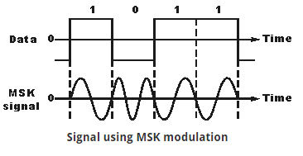
F. Modulation
The modulation scheme used by GSM system is 0.3GMSK where 0.3 describes 3db bandwidth of the Gaussian pulse shaping filter. Modulation block minimizes the occupied BW using GMSK modulation with BT of 0.3. By filtering the transmitted pulses this way, the intersymbol interference caused by the channel can be kept in control.
The channel data rate of GSM is 270.833 kbps which is four times the RF frequency shift. This minimizes bandwidth of the modulation spectrum and hence improves channel capacity.
MSK modulated signal is then passed through Gaussian filter to smooth the rapid frequency transitions which would otherwise spread energy in adjacent channels.
Here there are no phase discontinuities because the frequency changes occur at the carrier zero crossing points. The frequency difference between the logical one and logical zero states is always equal to half the data rate.
Notes:
In electronics and telecommunications, pulse shaping is the process of changing the waveform of transmitted pulses. Its purpose is to make the transmitted signal better suited to its purpose or the communication channel, typically by limiting the effective bandwidth of the transmission. By filtering the transmitted pulses this way, the intersymbol interference caused by the channel can be kept in control. In RF communication, pulse shaping is essential for making the signal fit in its frequency band. BT-Bit Time.
GSM (Global System for Mobile Communications,)

Slide 28
G. Demodulation:
The portion of the transmitted forward channel signal which is of interest to a particular user is determined by the assigned TS and ARFCN. The appropriate TS is demodulated with aid of synchronization data provided by the burst formatting.
In GSM cellular networks, an absolute radio-frequency channel number (ARFCN) is a code that specifies a pair of physical radio carriers used for transmission and reception in a land mobile radio system, one for the uplink signal and one for the downlink signal.
After demodulation the binary information is deciphered, de-interleaved, channel decoded and speech decoded.

Slide 29
Overview of GSM Timing Structures
8 Burst Periods (or 1 TS of a TDMA frame of 8TS = 576.9 μs) = 1 TDMA Frame (4.615 ms)
TDMA frames grouped into either:
26 TDMA frames (120 ms)
51 TDMA frames (235.4 ms)
to form a multi-frame (depending upon use of burst periods - signalling or traffic)
51 x 26 frame multi-frames, or 26 x 51 frame multi-frames form a super-frame (6.12 s)
2048 super-frames form a cryptographic hyper-frame (3 hr 28 min 53 s)
Notes:
GSM (Global System for Mobile Communications, originally Groupe SpécialMobile) is a standard developed by the European Telecommunications Standards Institute (ETSI) to describe the protocols for second-generation (2G) digital cellular networks used by mobile phones, first deployed in Finland in July 1991
the GSM standard originally described as a digital, circuit-switched network optimized for full duplex voice telephony.

Slide 30
0
1
2
3
2045
2046
2047
0
1
2
3
50
0
1
2
3
23
24
25
T0
T1
T2
T12
(SACCH)
T23
I
0
1
2
3
49
50
0
1
2
3
4
5
6
7
Notes:
The data of FACCH is transmitted by occupying one half of the bits in eight consecutive bursts, by stealling these bits from the TCH. For this purpose, the Stealing Flags of the bursts are set.
Gross Data Rate = Rate for Signaling, Synchronization, Guard Period + Rate for User Data (coded and enciphered) + Rate for SACCH and IDLE.
33.9 kbps = 9.2 kbps + 22.8 kbps +1.9 kbps
Each 51 consecutive time slots of a TDMA frame form a multiframe to form the structure for the transmission of the control channels which are not associated with a TCH ( all except FACCH and SACCH).

Slide 31
GSM CHANNELS

Slide 32
Introduction
In telecommunications a channel, refers either to a physical transmission medium such as a wire, or to a logical connection over a multiplexed medium such as a radio channel.
The channel used in the air interface is divided into two types: Physical channel and Logical channel.
Physical channel : It is the medium over which the information is carried.
Logical channel : It consist of information carried over a physical channel.

Slide 33
Physical Channel
When an MS and a BTS communicate, they do so on a specific pair of radio frequency (RF) carriers, one for the up-link and the other for the down-link transmissions, and within a given time slot. This combination of time slot and carrier frequency forms what is termed a physical channel .
One RF channel will support eight physical channels in time slots zero through seven.

Slide 34
Logical channels
It transports either user data during a call or signalling information for MS or base station.
The data, whether user traffic or signalling information, are mapped onto the physical channels by defining a number of logical channels .
Two groups of logical channels:
Traffic Channels, for call data
Control channels, to communicate service data between network equipment nodes.

Slide 35
From Physical Channel to Logical

Slide 36
Logical channels
Traffic channels (TCHs)
The traffic channels are intended to carry encoded speech or user data.
Control Channels (CCHs)
The control channels are intended to carry signalling and Synchronization data between the base station and the Mobile station. Logical are used by the system and the MS for different purposes

Slide 37
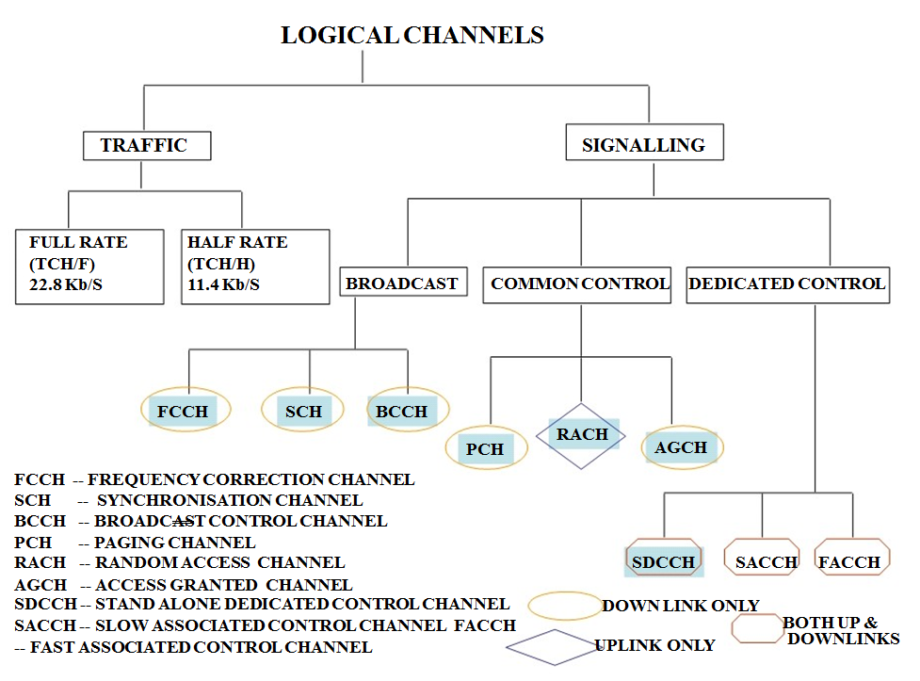
Classification of logical channel

Slide 38
Traffic Channel
Traffic channel (TCH) : Traffic channels are intended to carry encoded speech and user data. -Full rate traffic channels at a net bit rate of 22.8 Kb/s (TCH/F) -Half rate traffic channels at a net bit rate of 11.4 Kb/s (TCH/H) Speech Channels : Speech channels are defined for both full rate and half rate traffic channels. Data Channels : Data channels support a variety of data rates (2.4, 4.8 and 9.6 Kb/s) on both half and full rate traffic channels. The 9.6 Kb/s data rate is only for full rate application

Slide 39
Signalling channel
Signalling channels carry signalling information between an MS and a BTS.
There are several forms of control channels in GSM, and they can generally be divided into three categories according to the manner in which they are supported on the radio interface and the type of signalling information they carry.
Broadcast control channel
Common control channel
Dedicated control channel

Slide 40
Broadcast control channels
Broadcast control channels are transmitted in downlink direction only i.e. only transmitted by BTS.
The broadcast channels are used to broadcast synchronization and general network information to all the MSs within a cell.
Such as Location Area Identity (LAI) and maximum output power.
It has three types
FCCH- FREQUENCY CORRECTION CHANNEL
SCH -SYNCHRONISATION CHANNEL
BCCH- BROADCAST CONTROL CHANNEL

Slide 41
Frequency Correction Channel (FCCH):-
Used for the frequency correction / synchronization of a mobile station.
Repeated transmission (every 10 sec) of Frequency Bursts is called FCCH.
FCCH is transmitted on the downlink, point-to-multipoint.
Synchronization Channel (SCH):-
Allows the mobile station to synchronize time wise with the BTS.
Repeated broadcast (every 10 frames) of Synchronization Bursts is called (SCH)
SCH is transmitted on the downlink, point to multipoint.
Broadcast control channel(BCCH):-
The broadcast control channel(BCCH) is used to broadcast control information to every MS within a cell.
This information includes details of the control channel configuration used at the BTS, a list of the BCCH carrier frequencies used at the neighbouring BTSs and a number of parameters that are used by the MS when accessing the BTS.
BCCH is transmitted On the downlink, point-to-multipoint.

Slide 42
Common Control Channel
The common control channels are used by an MS during the paging and access procedures.
Common control channels are of following types
Random Access Control Channel (RACH)
Paging Channel (PCH)
Access Grant Control Channel (AGCH)
Cell Broadcast Channel (CBCH)

Slide 43
Random Access Control Channel :-
Transmitted by the mobile when it wishes to access to the system
This occurs when mobile initiates a call or responds to a page.
Paging Channel :-
Transmitted by the BTS when it wishes to contact a mobile.
The reason for contact may be an incoming call or short message.
Access Grant Control Channel :-
It carries data which instructs the mobile to operate in a particular physical channel (Time slot).
The AGCH is used by the network to grant, or deny, an MS access to the network by supplying it with details of a dedicated channel, i.e. TCH or SDCCH, to be used for subsequent communications
Cell Broadcast Channel :-
This channel is used to transmit messages to be broadcast to all mobiles within a cell e.g. traffic info.

Slide 44
Dedicated Control Channel
Signalling information is carried between an MS and a BTS using associated and dedicated control channels during or not during a call.
The are of following type :-
Standalone Dedicated Control Channel (SDCCH)
Associated Control Channel (ACCH)
Slow Associated Control Channel (SACCH)
Fast Associated Control Channel (FACCH)

Slide 45
Standalone Dedicated Control Channel (SDCCH) :-
The MS is on the SDCCH informed about which physical channel (frequency and time slot) to use for traffic (TCH).
It also carries information for call forwarding and Transmission of short message.
Associated Control Channel (ACCH) :-
These Channel Could be associated with either a SDCCH or a TCH.
They are used for carrying out information associated with the process being carried out on either SDCCH or TCH.
They are of two type: Fast ACCH and Slow ACCH
Slow Associated Control Channel (SACCH) :-
Conveys power control and timing information in the downlink direction.
Receive signal strength Indicator and link quality report in uplink direction.
It occupies one timeslot in every 26. SACCH messages may be sent once every 480ms, i.e. approximately every 2 s.
Fast Associated Control Channel (FACCH) :-
FACCH is transmitted instead of a TCH.
The FACCH steal the TCH burst and inserts its own information.
The FACCH is used to carry out user authentication and handover.
A complete FACCH message may be sent once in every 20 ms.

